Slide 1
Lecture 15: Introduction to Control
Introduction to control
Block diagram reduction

Slide 2
Introduction to Control
So far we have modeled systems and analyzed their time-response behavior
Specifications may exist based on response to simple inputs
If a system does not have desired response, then it can be modified with control
SYSTEM

Slide 3
Introduction to Control
simple to design (plant inversion)
ignoring D(s), Y(s) = P(s)C(s)R(s)
therefore, C(s) = 1/P(s) provides
Y(s)=R(s)
cheap (no sensor needed)
not robust
Open-loop control
(feedforward control)
D(s)
“controller”
“plant”
R(s)
C(s)
U(s)
+
P(s)
Y(s)
+
U(s)+D(s)
summing
point
Notes:
Can’t account for disturbances
Don’t know if the output is different than predicted

Slide 4
Introduction to Control
more robust
more complicated/expensive
can cause a stable system to
become unstable
response can be slower
Closed-loop control
(feedback control)
D(s)
R(s)
E(s)=
R(s)-Y(s)
“controller”
“plant”
+
C(s)
U(s)
+
P(s)
Y(s)
-
+
Y(s)
branching
point

Slide 5
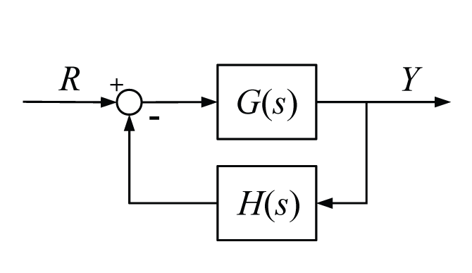
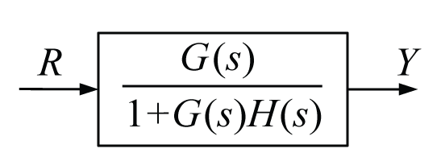
Block Diagram Reduction
Goal is to generate a transfer function from any given input to any given output of a block diagram

Slide 6
Block Diagram Reduction
Approach #1: Algebra
Define a variable after each summing point
Write equations and simplify
eliminate
E(s)
E
= GE
HY

Slide 7
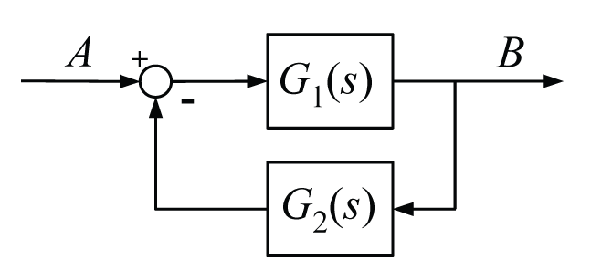
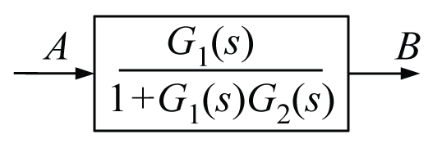
Block Diagram Reduction
Approach #2: Block diagram manipulation
Memorize rules for standard arrangements
Rule 1: Negative feedback
Rule 2: Positive feedback

Slide 8
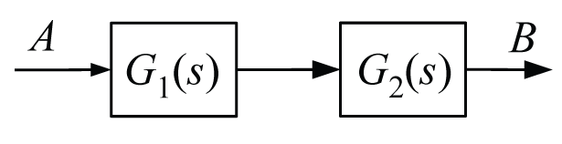
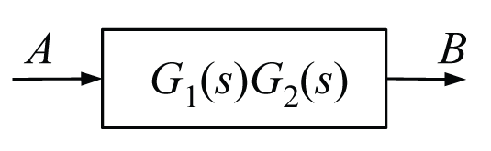
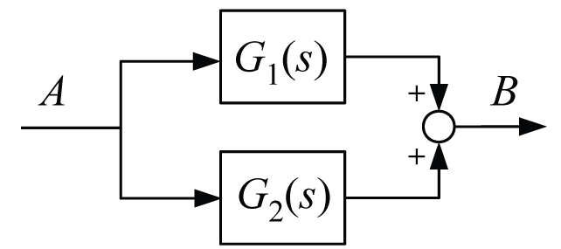
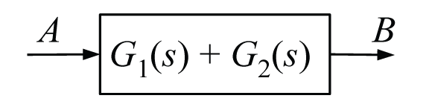
Block Diagram Reduction
Rule 3: Series
Rule 4: Parallel
AG₁
=AG₁G₂
AG₁
=AG₁+AG₂
AG₂

Slide 9
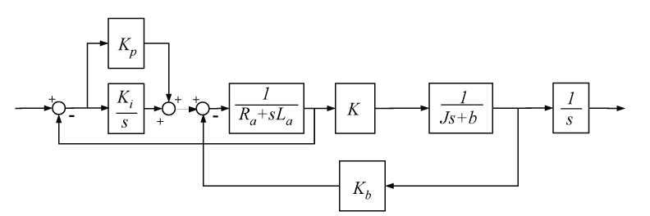
Example
DC motor torque control
controller
electrical
dynamics
mechanical
dynamics
e_{a}
.
i_{a,des}
i_{a}
T
θ
θ
e_{b}

Slide 10
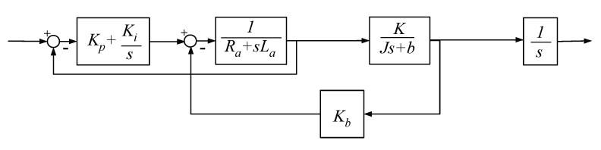
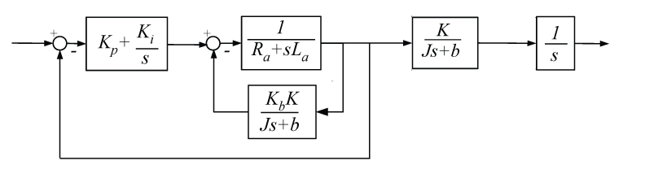
Does order of branching and summing points matter?
See table on page 495 of the book for more rules

Slide 11
Does order of branching and summing points matter?
See table on page 495 of the book for more rules

Slide 12
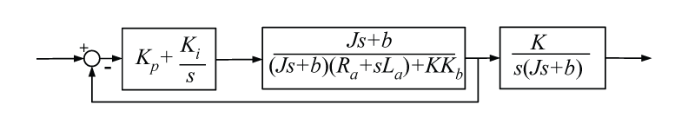
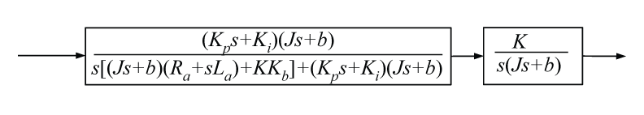
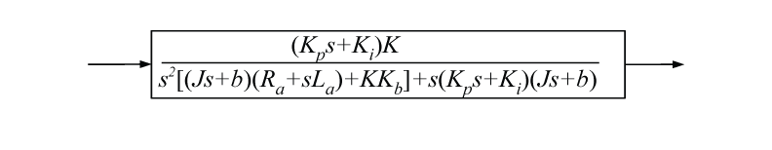
I_{a,des}
Θ

Slide 13
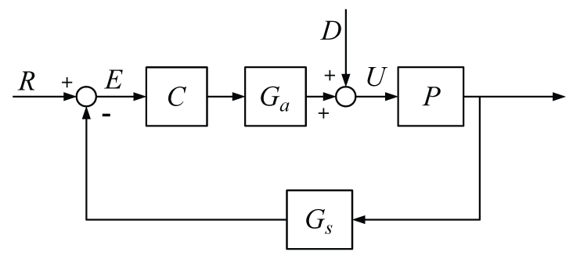
Total Response
For linear systems with multiple inputs the total response is the sum of the individual contributions (property of superposition)
Assume only one input is non-zero at a time
Y

Slide 14
Example
Total Response
Y

Slide 15
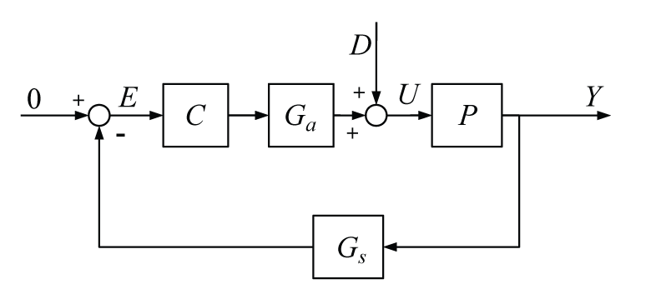
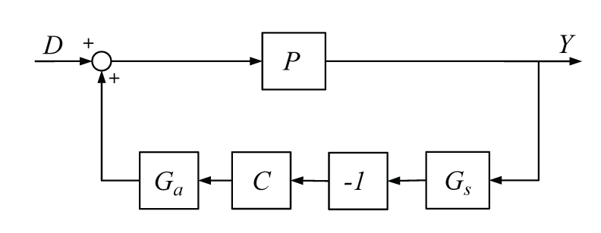
Example
Another way to think
about the transfer function

